Slide 1
Nigeria HPN Multi-Activity Evaluation
Kebbi Results Review Meeting
September 13, 2022

Slide 2

Meeting objectives
01
Share highlights from the Kebbi state findings of the Nigeria health, population, and nutrition (HPN) multi-activity evaluation.
02
Facilitate use of findings for state annual operational planning processes and for the annual Activity work planning process.
03
Increase awareness of how to access detailed results of the evaluation for ongoing program decision-making.

Slide 3
Agenda
10:05 – 10:45 am | Use of health services, health facility readiness, and provider knowledge, attitudes and practice: Kebbi baseline findings.
10:45 – 11:20 am | Sustainability of HPN activities: Kebbi baseline findings
11:20 – 11:45 am | Coordination and collaboration: Kebbi
11.45 – 12.00 pm | Wrap up and closing

Slide 4
Use of health services, health facility readiness, and provider knowledge, attitudes and practice
Kebbi baseline quantitative findings

Slide 5
Assessing the effectiveness of HPN Activities on the use of health services
Preliminary DHIS2 analysis
Notes:
We will focus our review of quantitative evaluation baseline findings on preliminary DHIS2 analysis of service delivery outcomes.

Slide 6
Data Source and Sample
Health facility-level data from Nigeria District Health Information Software 2 (DHIS2)
Monthly data from January 2017–March 2022 (63 time periods)
Exclusion criteria for preliminary analysis: ‘hospital’ or ‘private’ in facility name
Preliminary analytical sample: 900 Kebbi facilities
Notes:
Our first round of DHIS2 analyses used monthly DHIS2 health facility-level data from January 2017 through March 2022. We excluded from analysis those facilities that contained ‘hospital’ or ‘private’ in the facility name. The number of public primary health care facilities that met study eligibility criteria in Kebbi was 900 facilities.
NOTES TO SPEAKER:
- We have to assume the preliminary analytical sample only contains public facilities because we didn’t have a variable for public/private and didn’t have a facility type variable, so had to rely on information in the facility name.

Slide 7
Initial service delivery outcomes of interest
Malaria (under 5 years)
  Persons presenting with fever & tested by RDT
  Persons with confirmed uncomplicated malaria
  Persons with confirmed uncomplicated malaria treated with ACT
Descriptive comparison of trends over time
Antenatal Care
  1st ANC visit
  IPTp1
Family Planning
  New acceptors (female)
Notes:
We selected key indicators in pediatric malaria, antenatal care, and family planning service areas as initial service delivery outcomes of interest. For each indicator we examined reporting rates and monthly case volumes to understand trends over time.
Malaria indicators include persons under five years of age who: (1) presented with a fever and were tested by RDT; (2) had confirmed uncomplicated malaria; and (3) had confirmed uncomplicated malaria and treated with ACT. We will be conducting a cascade analysis of malaria services – from clients presenting with fever through clients diagnosed and treated – as a next step.
ANC and FP indicators include (1) first ANC visit for all gestational ages; (2) receipt of IPTp1; and (3) new female FP acceptors.

Slide 8
Preliminary Analytical Approach
DHIS2 data review: High rates of missing data at the facility-month level led to decision to analyze mean cases per month per facility at the state level as the main outcome.
Question
Indicator
Example calculation
How does facility-level reporting of health service delivery change over time?
% of facilities reporting service delivery indicator by month
# Kebbi facilities reporting # persons presenting with fever and tested by RDT in October 2021
Total # Kebbi facilities
How do state-level service delivery volumes change over time?
State-level average number of cases or clients per facility by month
Total # persons presenting with fever and tested by RDT in October 2021 across all Kebbi facilities
# Kebbi facilities that reported # persons presenting with fever and tested by RDT in October 2021
Notes:
Given high rates of missing data at the facility-month level, we analyze mean cases per month per facility at the state level as the main outcome.
In order to understand how facility-level reporting of malaria, ANC, and FP service delivery changes over time we graph the percentage of facilities reporting the service delivery indicator by month. This is calculated as the total number of facilities in the state that reported the indicator that month divided by the total number of facilities in the state.
In order to understand how state-level service delivery volumes change over time we graph the state-level average number of cases per facility by month. For example, a graph for Kebbi of first ANC visit client volume would be developed by dividing the total number of October 2021 ANC1 clients across all Kebbi facilities by the number of Kebbi facilities that reported on ANC1 in October 2021.

Slide 9
DHIS2 under-5 malaria reporting
Facility reporting rates have increased since January 2017 for all malaria indicators.
% Facilities reporting malaria indicators by month, Kebbi
Fever tested by RDT
Confirmed uncomplicated malaria
Confirmed uncomplicated malaria treated with ACT
Notes:
This graph presents the monthly percentage of facilities that reported the number of under-five patients for each malaria indicator in DHIS2: presenting with fever and tested by RDT; confirmed uncomplicated malaria; and confirmed uncomplicated malaria treated with ACT.
The percentage of facilities reporting all malaria indicators has increased over time. Reporting rates are equal for confirmed uncomplicated malaria and confirmed uncomplicated malaria treated with ACT. Reporting rates for fever cases tested by RDT are typically slightly higher than those for confirmed cases or treated cases. Reporting rates are equal for confirmed uncomplicated malaria and confirmed uncomplicated malaria treated with ACT.

Slide 10
Under-5 malaria service utilization
Case loads have experienced fluctuations due to seasonality with no overall strong trend. Nearly all confirmed malaria cases are treated with ACT.
State-level average number of cases per facility by month, Kebbi
Fever tested by RDT
Confirmed uncomplicated malaria
Confirmed uncomplicated malaria treated with ACT
Notes:
This graph presents the monthly average number of cases per facility at the state level for the three pediatric malaria indicators of interest.
We observe some seasonality during the entire study period, and the average number of under-five patients with fever tested by RDT, confirmed to have uncomplicated malaria, and treated with ACT remained stable. Case loads appear to have reached slightly higher levels than the observed at the start of the study period in January 2017.
We also observe that nearly all cases of confirmed uncomplicated malaria are reported to be treated with ACT.

Slide 11
DHIS2 ANC and FP reporting
Reporting rates for the first ANC visit, IPTp1 and new FP acceptors have increased somewhat over this period but are below 50%.
% Facilities reporting ANC and FP indicators by month, Kebbi
1st ANC visit
IPTp1
New FP acceptors
Notes:
On this slide we present the monthly percentage of facilities that reported ANC and family planning indicators of interest:
First antenatal visit attendance among pregnant women of all gestational ages
Pregnant women who received first dose of malaria intermittent preventive treatment
New female family planning acceptors
While the percentage of facilities reporting numbers of clients attending the first ANC visit and ITP1 have remained relatively stable throughout the study period, we observe improved reporting rates for new family planning clients.

Slide 12
ANC and FP service utilization
ANC1 and IPTp1 client loads relatively stable over time with some observed seasonality. New FP acceptor client loads have increased over the study period.
State-level average number of clients per facility by month, Kebbi
1st ANC visit
IPTp1
New FP acceptors
Notes:
Lastly, this graph presents the monthly average number of clients per facility at the state level for ANC, IPTp, and FP indicators of interest.
There appears to be some seasonality in first ANC visit and receipt of IPTp1; otherwise, client loads for these indicators have been relatively stable throughout the study period, with a slight decrease. The mean number of new FP users has increased over time.

Slide 13
Next steps for DHIS2 analysis
  Exclusion of facilities not providing services of interest
  True zero values vs. missing data
  Examination of outliers
Further data quality review
  Malaria service cascade
  Expanded indicator list
  Triangulation with population-based data
  Classification of facilities by intervention intensity
  Modelling
Additional analyses
Periodic result updates
  Refreshing DHIS2 data every 6 months
Notes:
The next steps of the evaluation’s ongoing DHIS2 analysis component include further data quality review and checks, additional analyses, and periodically updating results.
Immediate next steps in data quality review and data processing include examining patterns in missing data to understand which facilities do not provide a service of interest, are reporting zero cases in a particular month, or have missing data for a particular month. Missing data and outliers will then be treated by imputation as appropriate.
We will also present pediatric malaria indicators in a malaria service cascade format. Additional indicators will be analyzed based on data availability and quality, including malaria test positivity rates, IPTp3, disaggregation of the first ANC visit by pre/post 20 weeks gestational age, receipt of 4 or more ANC visits, and use of modern contraceptive methods.
We also plan to triangulate DHIS2 service delivery results with population-based data, for example the forthcoming MIS and MICS surveys.
Future analyses will attempt to classify health facilities by intervention intensity, and we are also interested in using the interrupted time series approach to estimate program effects on service delivery and/or understand COVID effects.
Lastly, we will pull new DHIS2 data every six months to track reporting rates, data quality, and service delivery volumes over time.

Slide 14
Assessing the effectiveness of HPN activities on health facility readiness
Evaluation baseline health facility assessment (HFA) results

Slide 15
Data Source and Sample
HFA data collected by IHP in Kebbi between August 3 – 22, 2020
Additional HFA data was collected by D4I at health facilities between July 5 – August 12, 2021
Evaluation analytical sample: 120 Kebbi facilities
  88% primary health centers
  85% rural settings

Slide 16
HFA results:
A. General service readiness

Slide 17
General Service Readiness
49% of facilities have all essential medicines available. The mean percentage of essential medicines available at a facility is 79%.
Percentage of Kebbi facilities that have essential medicines available (N=120)
Paracetamol tab/cap
Hormonal contraceptives (oral, injectable, and/or implants)
Artemisinin-based combination therapy (ACT)
Folic acid tab/cap

Slide 18
General Service Readiness
46% of facilities have all basic consumables available. The mean percentage of basic consumables available at a facility is 79%.
Percentage of Kebbi health facilities that have basic consumables available (N=120)
Male condoms
Sterile gauze swabs
Alcohol swabs
Examination gloves, latex, single use
Single use syringes

Slide 19
HFA results:
B. Malaria service availability and readiness

Slide 20
Malaria Service Availability
99% of facilities offer malaria diagnostic and treatment services, and 98% provide IPTp.
Percentage of Kebbi health facilities that offer specific malaria services (N=120)
IPTp
Malaria treatment
Malaria diagnosis

Slide 21
Malaria Service Availability
99% of facilities provide malaria diagnosis by testing: 99% offer RDT, 27% clinical diagnosis, and 8% microscopy
Percentage of Kebbi health facilities that offer specific malaria diagnostic services (N=120)
Malaria diagnosis by RDT
Malaria diagnosis by testing
Malaria diagnosis by clinical symptoms and signs
Malaria diagnosis by microscopy

Slide 22
Malaria Service Readiness
100% of facilities have staff trained to diagnosis and treat malaria. 90% of facilities had malaria diagnostic testing capacity.
Percentage of Kebbi health facilities that are ready to provide Malaria services today (among facilities providing malaria services) (N=119)
Staff trained in malaria diagnosis and treatment
Guidelines for diagnosis and treatment of malaria
Malaria diagnostic testing capacity

Slide 23
Malaria/ANC Service Readiness - IPTp
93% of facilities offer IPTp in ANC. Among facilities offering ANC services, 98% had staff trained in IPTp and 63% had IPTp medicine available.
Percentage of Kebbi health facilities ready to provide IPTp care (among facilities providing IPTp) (N=115)
Facility has IPT medicines
Facility has staff trained in IPTp
Facility has guidelines on IPTp

Slide 24
Malaria Service Readiness
On average, facilities had 80% of all malaria staff/guidelines, diagnostic, and medicines/commodities items available; only 2.5% of facilities had all items.
Mean percentage of items available to provide malaria services today (among facilities providing malaria services) (N=119)
Mean % of malaria diagnostic items
Mean % of malaria staff and guidelines items
Mean % of malaria medicines and commodities items
Mean % of all malaria items at facilities
Notes:
Malaria diagnostic items: RDT kits, smear kits, microscopy
Malaria staff and guideline items: guidelines for diagnosis and treatment, guidelines for IPTp, staff trained in malaria diagnosis and treatment, staff trained in IPTp
Malaria medicines and commodities: first-line antimalarials, paracetamol tab/cap, sulphadoxine-pyrimethamine (SP) tab/cap, ITN or ITN vouchers
All malaria items: medicines and commodities, diagnostic items, staff and guidelines

Slide 25
Malaria Service Readiness - Stockouts
During the previous 4 weeks, 1 in 4 facilities experienced RDT stock outs and 1 in 5 experienced 1st line antimalarial stock outs.
Percentage of Kebbi health facilities that experience stock outs by type and length
RDTs
1st line antimalarials
● Less than 7 days | ● 7-14 days | ● More than 14 days

Slide 26
HFA results:
C. Antenatal care and family planning service availability and readiness

Slide 27
ANC Service Availability
96% of facilities offer antenatal care services.
Percentage of Kebbi health facilities that offer specific ANC service (N=120)
Routine checks for urine protein
Monitoring for hypertensive disorder of pregnancy
Tetanus toxoid vaccination
IPTp
Folic acid supplementation
Iron supplementation
ANC services

Slide 28
ANC Service Readiness
On average, facilities had 69% of all ANC items available; no facility had all ANC items.
Mean percentage of items available to provide ANC services today (among facilities providing ANC services) (N=115)
Mean % of ANC diagnostic items at facilities
Mean % of ANC medicines and commodities items at facilities
Mean % of ANC equipment items at facilities
Mean % of ANC staff and guidelines items at facilities
Mean % of all ANC items at facilities
Notes:
ANC Diagnostic items: haemoglobin testing capacity, urine dipstick-protein test
ANC medicines & commodities: insecticide treated nets (ITNs), IPT medicine, tetanus toxoid vaccine, iron tablets, folic acid tablets
ANC equipment: iron tablets, adult weighing scale, fetal stethoscope, blood pressure apparatus
ANC staff & guidelines: national guidelines on ANC, ANC check-lists and/or job-aids, staff trained in ANC, national guidelines on IPTp, IPTp checklists and/or job-aids, staff trained in IPTp
All ANC items: diagnostic items, medicines and commodities, equipment, staff and guidelines

Slide 29
FP Service Readiness
95% of facilities offer family planning services. On average, these facilities had 86% of all family planning items available.
Percentage of Kebbi health facilities with the capacity to provide family planning services on the day of assessment (N=114)
Blood pressure apparatus
Staff trained in FP
Any modern methods available
3 or more modern methods available
Facility has all FP items

Slide 30
Assessing the effectiveness of HPN activities on providers’ knowledge, attitudes, and practices
Evaluation baseline provider survey results

Slide 31
Data Source and Sample
4 modules: Background, Training, Clinical Vignettes, and Provider Attitudes and Norms
Up to 5 providers/facility interviewed. Eligibility criteria included:
  Present at facility on day of survey
  Provide out-patient services
  See sick children, ANC, and/or family planning patients
Fieldwork: July 1 – August 12, 2021
Ebonyi provider survey sample size: 354 providers from 120 PHCs
Notes:
The provider instrument assessed malaria, child health, FP and ANC outcomes in the TOC related to quality of care; namely client-provider interactions and provider knowledge, attitudes, and practices.

Slide 32
Provider survey results:
A. Provider Background

Slide 33
Provider Demographics, Experience, and Tenure
The average provider in Kebbi. . .
Female (57%)
41 years of age
15 years of education
Received technical qualifications/basic training 14 years ago
Nearly 4% were professional health workers
Has worked at current facility for 11+ years (26%), with an average of 8 years
3% seconded
Notes:
We categorized doctors, registered nurses, midwives, nurse midwives, public health officers, and laboratory scientists as professional providers. The non-professional health worker cadre includes public health associates, laboratory technicians, environmental health officers, pharmacy and dental technicians, health information/medical records technicians, community health officers, community nurses and midwives, community health extension workers, nurse aids, and other health workers with no technical qualifications.
Nearly 30% of providers interviewed in Ebonyi were professional health care workers. In Ebonyi, registered nurses and registered nurse midwives comprised the majority of the professional health cadre. The vast majority of non-professional health workers were Community health extension workers, followed by JCHEW.
Professional includes: doctors, registered nurses, midwives, and nurse midwives, public health officers, and laboratory scientists
Non-professional includes: Public health associates, laboratory technicians, environmental health officers and associates, pharmacy technicians, dental technicians, health information/medical records technicians, community health officers, community nurses and midwives, CHEW (community health extension workers), JCHEW (junior community health extension workers), nurse aides, and health workers with no technical qualifications.

Slide 34
Services Provided
Most clinicians provide malaria, child health, antenatal care services, and family planning services.
Services health worker personally provides in current position at facility (N = 371)
Malaria
%
Child health services
%
Antenatal care
%
Family planning services
%
Notes:
The provider survey focused on four major clinical care areas: malaria, child health services, antenatal care, and family planning.
At nearly all facilities we interviewed all providers performing services at the clinic on the day of the interview. In Eboyni the same health workers are likely to be performing multiple care types

Slide 35
Provider survey results:
B. Training

Slide 36
General Training
88% of health workers reported receiving training in any of the specified general topics.
Percent of health workers who received training on general topics (N = 371)
Safe injection practices
Approximately 4 out of 5 providers reported receiving training on safe injection practices and on standard precautions
Roughly 1 in 2 providers reported receiving training on GBV
General training typically received within past 2 years
%
%
Standard precautions
%
%
HMIS/reporting
%
%
GBV
%
%
Notes:
88% of providers in Kebbi reported having ever received training in any of the specified general topics – safe injection practices, standard precautions around hygiene and injury prevention, health management information systems or reporting requirements, and gender-based violence.
The total length of each bar represents the percentage of health workers who ever received training; the dark shading indicates training was in the past two years and light shading indicates over two years ago. Most general training in Kebbi is reported to have occurred in the past 2 years.

Slide 37
Malaria
95% of respondents personally diagnose and/or treat malaria. 90% of these health workers reported receiving training in any of the specified malaria topics.
Percent of malaria providers who received training on malaria topics (N = 352)
mRDT performance
More than 4 out of 5 providers report receiving training for all malaria topics.
Most providers report receiving training in the past 2 years.
%
%
Diagnosing malaria in children
%
%
Case mgmt/tx of malaria during pregnancy
%
%
IPT of malaria in pregnancy
%
%
Notes:
OLD NOTES
Service area-specific training analysis was restricted to those providers who personally provide the service in their current position at the sampled facility. This corresponds to the service area slide we reviewed at the end of the background section.
Nearly all providers in Ebonyi and Kebbi and 87% in Zamfara provide malaria services in their current position. Again we see high training levels in Kebbi, particularly recent training in the past two years, and overall higher training levels in Zamfara.
Malaria training levels are high across the three states compared to the other health service areas – child health, family planning, and antenatal care.
P-values for 3 training categories (never, 2+ years, past 24 months)
Diagnosing malaria in children 0.000
mRDT performance 0.000
Case management/treatment of malaria during pregnancy 0.000
IPT of malaria in pregnancy 0.000
Similar findings as general training – K and Z are higher, recent highest in K

Slide 38
Antenatal Care
62% of respondents provide ANC services. 90% of these health workers reported receiving training in any of the specified ANC topics.
Percent of ANC providers who received training on ANC topics (N = 230)
IPT of malaria during pregnancy
Approximately 2 out of 3 providers have received male engagement training and 3 out of 4 have received partner communication training in Kebbi
Counseling for ANC
Pregnancy comp. and mgmt.
ANC screening
Nutritional assessment of preg. women
Male engagement in ANC
Partner communication in birth planning
Notes:
OLD NOTES
Lastly, we asked about antenatal care service training on IPT of malaria during pregnancy, ANC screening and counseling, identification and management of pregnancy complications, nutritional assessment of pregnant women, male engagement in ANC, and partner communication around birth planning.
Recall that nearly all Ebonyi health workers provide ANC services, compared with just over 60% in Kebbi and about a third in Zamfara. While there is low ANC service provision in Zamfara, the providers tend to have moderate-high levels of training.
Again we find that most ANC-specific training in Kebbi is recent, and occurred over two years ago in Zamfara. Similar to family planning training we find that training specific to male engagement and partner communication in ANC and birth planning are low.
P-values for 3 training categories (never, 2+ years, past 24 months)
ANC screening 0.000
Counseling for ANC 0.000
Complications of pregnancy and their management 0.000
Nutritional assessment of the pregnant woman 0.000
IPT of malaria during pregnancy 0.008
Partner communication in birth planning 0.000
Male engagement in ANC 0.000

Slide 39
Family Planning
66% of respondents provide FP services. 84% of these health workers reported receiving training in any of the specified FP topics.
Percent of FP providers who received training on FP topics (N = 245)
General counseling for FP
More than 70% providers report ever receiving training on most FP topics.
Most training is reported to have occurred in the past 2 years.
Implant insertion/removal
Clinical mgmt of FP methods
Post-partum FP
IUCD insertion/removal
Male engagement in FP
Partner communication for FP
Notes:
Old notes
Family planning service provision was lowest across the three states, as was family planning-specific training among providers. Only 65% of family planning providers in Ebonyi and 81 to 84% in Zamfara and Kebbi received training in the specific family planning services mentioned – general counseling, implant and IUD insertion and removal, clinical management of methods, postpartum family planning, and male engagement.
The large majority of family planning training in Kebbi has occurred within the past two years, compared to a majority in Zamfara over two years ago. This aligns with partner efforts in the two states, particularly the disease-focused approach in Zamfara.
Training specific to male engagement and partner communication for family planning are low in Ebonyi and Zamfara.
P-values for 3 training categories (never, 2+ years, past 24 months)
General counseling for family planning 0.000
IUCD insertion and/or removal 0.000
Implant insertion and/or removal 0.000
Clinical management of FP methods, including managing side effects 0.000
Post-partum family planning 0.000
Partner communication for family planning 0.000
Male engagement in family planning 0.000
Other 0.003

Slide 40
Provider survey results:
C. Attitudes and Norms

Slide 41
Provider Attitudes and Norms
Are provider attitudes different from perceived professional community norms among other providers in LGA?
  Topic 1. Malaria, ANC, and FP attitudes, practices, and norms
  Topic 2. Gender attitudes and gender-sensitive quality of care norms
Notes:
We wanted to understand provider attitudes toward malaria, antenatal care, and family planning practices, and are also interested to learn if provider attitudes differ from their perceptions of professional community norms. We first asked providers to describe how strongly they agree or disagree with statements about malaria case management, family planning, and ANC service provision, then asked them to describe how often they thought other providers in their LGA performed the activities .
In addition to asking them about service-specific care, we asked clinicians to respond to a series of statements related to RMNH service provision and quality of care to develop a provider gender attitude score. We also asked them about their perceptions of gender-sensitive community quality of care in their LGA.
ANC questions adapted from Breakthrough Research’s Nigeria Behavioral Sentinel Survey baseline questionnaire
- White Johansson, Emily, Paul Hutchinson, Elizabeth Omoluabi, Akanni Akinyemi, Andrea Smith, J. Clint Welty, Udochisom Anaba, Dominique Meekers, Alejandra Leyton, Dele Abegunde, and Paul C. Hewett. 2020. "Behavioral Sentinel Surveillance Survey in Nigeria," Breakthrough RESEARCH Baseline Technical Report. Washington, DC: Population Council.

Slide 42
Key findings: Provider attitudes and LGA norms
Malaria case management attitudes and norms are generally positive at Evaluation baseline and align with corresponding community norms
ANC provider attitudes are universally positive at evaluation baseline
LGA norms on ANC also positive in Kebbi
  Exception: reported LGA norms around mosquito net provision are less positive than corresponding provider norms
97% providers agree or strongly agree that it is appropriate to require partner consent before providing contraceptives to women
48% providers agree/strongly agree that it is not appropriate to provide contraceptives to unmarried women.

Slide 43
Key findings: Provider gender attitudes and LGA norms
Gender norms among providers and LGA norms are not highly gender equitable in Kebbi.
Almost all providers agreed or strongly agreed with statements expressing supportive LGA norms on couples’ communication and individual agency in family planning service provision
52% providers agreed or strongly agreed with the statement “the clinicians in this LGA believe that men’s only role in family planning should be to help select methods used by their female partner”

Slide 44
Provider survey results:
D. Clinical Vignettes

Slide 45
Child Health Vignette
Child health: Domain and weighted total scores
Case: uncomplicated malaria in child age 5 years.​
Key findings
99% of providers would perform mRDT
94% of providers would treat with ACT
22% providers would provide an antibiotic
Only 2 providers in Kebbi mentioned disclosing the diagnosis in counseling
35% of providers would counsel on completing medication to avoid drug resistance
 |  | ● Kebbi (N=312) |  | P-value
Weighted total |  | 50.7 |  | 0.000
Notes: *** p<0.001 | Notes: *** p<0.001

Slide 46
ANC: Malaria in Pregnancy Vignette
ANC-MIP: Domain and weighted total scores
Key findings
Vignette focuses on treatment of a woman presenting with malaria in pregnancy
Nearly universal malaria testing (99.5%) and treatment with ACT (91%)
 |  | ● Kebbi (N=218) |  | P-value
Weighted total |  | 72.4 |  | 0.910
Notes: *** p<0.001 | Notes: *** p<0.001
Notes:
Limitation of this vignette is that it focuses on non-ANC and malaria testing/diagnosis/treatment. It does not follow standard MIP/IPTp protocol.

Slide 47
Family Planning (Implant) Side Effects Vignette
FP-SE: Domain and weighted total scores
Key findings
14% of providers would not offer counseling on another FP method
  Most common reason is that side effects are normal
Among providers who would offer another method:
  53% would counsel on all methods available from any source
  64% would counsel on methods available at the facility today.
  78% of providers would refer the client to another clinic if her preferred method is unavailable
 |  | ● Kebbi (N=204) |  | P-value
Weighted total |  | 55.4 |  | 0.000
Notes: * p<0.05; *** p<0.001 | Notes: *** p<0.001

Slide 48
Post-partum Family Planning Vignette
Key findings
95% of providers would counsel the client in choosing a post-partum contraceptive method
56% of providers would counsel on FP methods that can be used during breastfeeding
28% of providers would counsel on birth planning to get FP at time of delivery
67% of providers said that the earliest time to get PPFP is at the time of delivery; 17% said at 6-week post-natal check up.
PPFP: Domain and weighted total scores
 |  | ● Kebbi (N=204) |  | P-value
Weighted total |  | 58.9 |  | 0.003
Notes: * p<0.05; ** p<0.01 | Notes: *** p<0.001

Slide 49
Male Engagement in FP Vignette Content
MEFP: Domain and weighted total scores
Key findings
Scores on male engagement in family planning items are generally relatively low
22% of providers offered joint couple counseling on PPFP if the woman wanted it
30% of providers asked the woman about joint discussion/decision-making about FP in PPFP vignette
 |  | ● Kebbi (N=204) |  | P-value
Weighted total |  | 16.1 |  | 0.035
Notes: * p<0.05; *** p<0.001 | Notes: *** p<0.001

Slide 50
Gender-Based Violence Vignette Content
GBV: Domain and weighted total scores
Key findings
39% of providers would implement GBV screening
5% of providers mentioned looking for signs of physical violence in the physical exam
5% of providers in Kebbi diagnosed explicit GBV risk
 |  | ● Kebbi (N=218) |  | P-value
Weighted total |  | 18.1 |  | 0.044
Notes: * p<0.05; *** p<0.001 | Notes: *** p<0.001

Slide 51
Provider survey results:
Conclusions

Slide 52
Conclusions
Overall
Indicators related to malaria (training, attitudes and norms, vignettes) tend to be highly positive → not a lot of room for improvements over time
More variation in indicators for ANC, FP
Gender
Training on gender issues (GBV, male involvement in FP) higher in Kebbi than in other states in study.
Few providers screened for GBV in pre-eclampsia/GBV ANC vignette
Gender norms among providers are not highly gender equitable

Slide 53
Sustainability of HPN Activities
Kebbi baseline findings

Slide 54
Baseline findings on sustainability
A. Methods

Slide 55
Defining sustainability
In Kebbi, IPs and government staff expressed similar perceptions:
USAID defines sustainability*:
“the capacity to maintain program services at a level that will provide ongoing prevention and treatment for a health problem after termination of major financial, managerial and technical assistance from an external donor.”
Ability of the government to take ownership of activities [that IPs implemented] and continue running them even when the IPs is not there anymore.
– Kebbi SMOH staff
Ability of the state to continue [IPs’ activities] even when support or funding ceases from partners, so that people will continue to benefit.
– Kebbi IP staff
*Sustainability of Development Programs: A Compendium of Donor Experience. Washington, DC: US Agency for International Development; 1998
Notes:
For this assessment, we used USAID’s definition of ‘sustainability’ as follow: “Sustainability is the capacity to maintain program services at a level that will provide ongoing prevention and treatment for a health problem after termination of major financial, managerial and technical assistance from an external donor.”
Interviews with implementing partners and government staff in Kebbi state indicated similar perception about sustainability.

Slide 56




Conceptual framework for sustainability assessment
Activities
Elements Influencing Sustainability
Institutionalization
Ultimate Outcomes
State MOU
State AOP
Program implementation
Strategic program planning
Program adaptability and alignment
Effective engagement and collaboration
Demonstrating program results
Transition
Increased capacity of State programs/structure
Increased sustainability of health systems and health outcomes
Increased capacity of State health promotion team and structures
Increased capacity of State FP/MNCH/PHC teams and structures
System/organizational capacity
Resource and funding stability
Leadership competence
State govt. staff involvement & integration
System flexibility to adapt to change
Effective coordination and collaboration
Routinization
Increased capacity of State EDDS teams & structures
Increased capacity of State malaria program and structures
Institutionalization
Improved information used for decision-making
Increased capacity at community level
Community embeddedness
Program-community partnership
Community leadership involvement
Community participation & accountability
Public health impacts
Improved patient HMIS quality and use
Strengthened Facility Management Committees (FMC)
System
feedback/response
Strengthened LMIS quality and use
Strengthened Ward Development Committees (WDC)
Enabling environment
Advocacy/communications
Political support and acceptance
Government and local policy alignment
BA-N
IHP
Learnings from early transition phase for continuous improvement
PMI-S
PSM
IHP (Kebbi), PMI-S (Zamfara), IHP/PMI-S (Ebonyi)
All activities
Notes:
A conceptual framework was developed to guide the sustainability assessment. Specifically, we hypothesize that by engaging government partners in health system strengthening interventions, the four implementing partners will make the interventions into a routine practice in the government health system, and then will gradually turn them into common practice within the government system. During the engagement and routinization process, the IPs will continue working with government partners to collect feedback and make adjustment as needed. Elements influencing sustainability were drawn from literature. Specifically, we look into 4 key domains: Program implementation, system/organizational capacity, community embeddedness and enabling environment.

Slide 57
Sustainability survey
Questionnaire was adapted by D4I from the Program Sustainability Assessment Tool (PSAT)**
Includes statements that characterize sustainable programs, organized into 12 domains across 3 functional areas
Likert-type response scale anchored by ‘to an extremely small extent’ (1) and ‘to an extremely large extent’ (7)
A total of 161 staff members (24% female, 76% male) from HPN stakeholder organizations took part in the assessment February–March 2022
**Center for Public Health Systems Science (2021). Program Sustainability Assessment Tool (PSAT). Brown School of Public Health, Washington University in St. Louis. Retrieved from https://sustaintool.org/psat/ in June 2022. (available under a Creative Commons Attribution-Non-Commercial-Share-Alike license)

Slide 58
Qualitative interviews
Interview guides were developed for HPN Activity, State, and USAID respondents focusing on:
  Program implementation
  Collaboration/coordination
  System/organizational capacity
  Community embeddedness (BA-N only)
  Enabling environment
  Institutionalization
24 key informant interviews (KIIs) conducted at the Federal and state levels:
Participant | Sample size
 | Ebonyi | Kebbi | Zamfara | Abuja FCT
HPN Activity staff | 4 | 3 | 3 | 3
Government staff | 3 | 3 | 2 | 0
USAID | 0 | 0 | 0 | 3
TOTAL | 7 | 6 | 5 | 6

Slide 59
Baseline findings on sustainability:
B. Program implementation

Slide 60



What sustainability strategies are implementers using?
Communicate the purpose and goals of the sustainability plan with stakeholders at the beginning of the design process
Engage and support not only state-level stakeholders but also LGA- and grassroot-level leaders in the implementation process
Gender integration
Align interventions that include a sustainability plan alongside state’s annual operational plans
Co-locate activity office
within state Ministry of Health’s office complex
Commitment & engagement
Capacity
Integrate gender aspect in practice and interventions by including a gender focal person to facilitate gender incorporation into scope of activities
Notes:
Activities have employed various strategies to ensure their implementing programs sustainable.

Slide 61
Key survey findings
Score are generally consistent across all measures on program implementation.
Average ratings were generally 5.0 (“to a large extent”) for survey items in this domain.
  Alignment of Activities’ work plan with the state Memorandum of Understanding (MOU) was rated highest (at 5.6) in this domain.

Slide 62
Program adaptability and alignment scores
Scores are generally consistent across all measures
Notes:
Scores are generally consistent across all measures, in which Alignment of Activities’ work plan with the state Memorandum of Understanding (MOU) was rated highest (at 5.6) for Program Adaptability and Alignment scores.

Slide 63
Program adaptability and alignment
Improvement [the Activity] is trying to achieve aligned with the priorities of the state health plans and goals. For example, goals for state drug management agency and lower morbidity and mortality rates.
For critical coordination point with [the Activity] specifically is when there are things in their plans that involve Department of Planning Research and Statistic (DPRS). For example, they engaged frequently with the department during the annual operation plan where implementing partners took responsibilities of supporting DPRS to developed it.
– Kebbi SMOH staff
– Kebbi SMOH staff
Notes:
Interviews with Kebbi government staff and IPs also reflect the quantitative findings.

Slide 64
Effective engagement and collaboration scores
Scores are generally consistent across all measures
Notes:
Ability of Activities to conduct regular advocacy to raise awareness among policymakers for policy change and increased funding was rated highest (at 5.3) for Effective Engagement and Collaboration scores​.

Slide 65
How do Activities collaborate with state government?
Participate in planning and monitoring state government’s health plans (i.e., planning SMOH AOP & malaria AOP, and monitoring PHC MOU, etc.)
[Activity]’s approach integrated into DPRS operations is generally good. For example, the score card is one and Kebbi is the only state using multisectoral which cut across many areas. There is remarkable improvement by [the Activity]’s intervention.
– Kebbi SMOH staff
Provide technical support in health programming (i.e., tools for monitoring data quality, meetings for TWGs, coordination, and malaria AOP review, etc.)
[Activity] gave Logistics Management Coordination Unit (LMCU) technical support through bimonthly report collections and biannual reviews of end-use verification. All of these have been the backbone of the LMCU.
– Kebbi SMOH staff
Strengthen capacity on health programming and data use (i.e., training on malaria score chart development, end user verification, etc.)
Notes:
Activities have collaborated with Kebbi state government agencies through various forms.

Slide 66
Demonstrating program results scores
Scores are lowest in this measure
Notes:
Both “Activities’ capacity for quality implementation approach M&E” and “the association of Activities implementation with improvement of health outcomes” were rated highest (at 5.3) in Demonstrating Program Results scores. ​And “Activities share results that include gender measures” was rate lowest (at 4.2).

Slide 67


Facilitators vs. barriers to program implementation
  Facilitators
  Barriers
IPs’ internal and external reviews of activity implementation progress on a regular basis
Generation and use of data for activity planning, including data on gender
Support from state government leaders to IPs’ activities
‘Learning-based concept’ of IPs’ approaches enables IPs to adjust and adapt quickly with context changes
Lack of support from state government leaders to vision and objectives of IPs’ activities
Limited communication about IPs’ activities to general public
Limited capacity among state government leaders/staff
Participation of government staff who are less relevant to IPs’ activities due to busy schedule of the main staff
Interrupted implementation timeline due to scheduling conflict between IPs’ and state’s activities

Slide 68
Baseline findings on sustainability:
C. System/organizational capacity

Slide 69
Key survey findings: System/organizational capacity
Scores are markedly lower than for program implementation, with some items average in the ‘moderate’ range
Scores for items in the resource and funding stability domain are lowest, generally averaging below 4.0 (‘moderate’)
For state government leadership and state government staff involvement, rankings vary by item within the domain. Items for leadership competence average in the ‘less moderate’ range more often than items for staff involvement.

Slide 70
Resource and funding stability scores
Scores are highest on this measure
Notes:
“Activities’ approaches are funded through a variety of sources” was rated highest (at 4.6) in Resource and Funding stability scores. Other measures, such as “adequate staff and resources, sustained fundings for implemented approaches” were rate lowest (at 3.7).

Slide 71
Resource and funding stability
Currently, the Logistics Management Coordination Unit (LMCU) does not have any cash allocation or budget. The LMCU central medical store burned four years ago and has not been rebuilt, so there is poor financial support from the state government. LMCU has implemented a lot of advocacies and there were promises, but they have yet to be fulfilled.
There has been an increase in funding for health, but the percentage is not increasing when looking at government general health expenditure (GHE). GHE is not commensurate to previous year, so government budgeting is not realistic. The challenges are not particular to Kebbi alone but is a general issue in the country.
– Kebbi SMOH staff
– Kebbi IP staff

Slide 72
State government leadership competence scores
Scores are highest on this measure
Scores are lowest on this measure
Notes:
“State government leadership team comprise both women and men at senior management level” was rated highest (at 4.9) in State government leadership competence scores. And ability of state government leadership to provide strong supervision and support was rated lowest (at 3.6).

Slide 73
State government involvement and integration scores
Scores are highest on this measure
Scores are lowest on this measure
Notes:
“State government team comprise both women and men” was rated highest (at 5.2) in State government leadership competence scores. And training for government staff in required skills for approach implementation was rated lowest (at 3.8)

Slide 74
Baseline findings on sustainability:
D. Enabling environment

Slide 75
Key survey findings: Enabling environment
Scores are largely consistent across all measures, with state averages above 4.5 (‘moderate’) for survey items in this domain.
Advocacy/communication measures score highest in this domain.

Slide 76
Advocacy/communications scores
Scores are generally consistent across all measures
Notes:
Activities’ communication strategies to secure and maintain public support was rated highest (at 5.4) in Advocacy/Communication scores​.

Slide 77
Advocacy & communications: Successes vs. challenges
During advocacy, the Government makes pledges but eventually doing it is a problem. One of the challenges is the capacity (i.e., gap for implementation of activities for result-based advocacy, even within the WDCs).
– Kebbi IP staff
PSM
BA-N
USAID [Activities] doing advocacy is a big deal, and it will make more impact on the state government leaders than the LMCU doing the advocacy because there would be more bilateral engagement.
– Kebbi SMOH staff
IHP
Notes:
Updated

Slide 78
Political support and acceptance scores
Scores are highest on this measure
Scores are lowest on this measure
Notes:
“Public support to the Activities” was rated highest (at 5.0) in political support and acceptance scores. And Activities’ approaches have strong government champion with ability to garner resources was rated lowest (at 4.1).

Slide 79
Political support and acceptance
Gender has come up strongly especially on sexual assault referral (SAR). There is a center and TWGs now because of the leadership of first lady in the group. She gets funding even from outside the state and the training on this was done by SAR center of Lagos through her connections, the facilitators from Lagos do the training through pro-bono to develop the Kebbi center.
If Department of Planning Research and Statistic (DPRS) has activities in the communities, government supports the department by providing venue, sometimes logistics, and covering securities to create enabling environment, access and acceptance of the communities.
– Kebbi IP staff
– Kebbi SMOH staff
Notes:
Interviews with Ebonyi government staff and IPs also reflect the quantitative findings.

Slide 80
Baseline findings on sustainability:
E. Fostering sustainability in practice

Slide 81
Fostering sustainability in Kebbi
Organization of MOU review meetings
Development of state annual operational plan (AOP)
Monitoring and reporting of state facility budget
Implementation of gender integration in health programming such as gender balance among participants in the ward development committees (WDCs) and Roll Back Malaria program
Practice of data use, data quality monitoring, and data validation, including the use of data validation tool when writing reports
Engagement of traditional rulers, WDCs, and community volunteers in creating awareness about access to health services
Practice of weekly monitoring and supervision of LGA coordinators
IHP
BA-N
PSM
Notes:
From the key informant interview, we were able to draw out a list of specific practices that the three Activities have engaged and collaborated with Kebbi state government ministries and agencies.

Slide 82
Coordination and collaboration:
Kebbi findings

Slide 83




Steps in the organizational network analysis (ONA)
Each HPN Activity identifies up to 10 collaborating organizations; the Activities and their collaborators form the sample.
Respondents name “the 10 main organizations that your organization coordinates with [for HPN Activities]” – some are also respondents.
Respondents are asked about resource and information exchange with each organization that they nominated in step 2
The responses from step 3 are used to generate data and diagrams reflecting each type of exchange
Notes:
First I want to briefly describe the sampling and the questions we used. In step 1...

Slide 84
Network density
How commonly do these organizations share resources or information (with any frequency)?
Low density
High density
Notes:
The first measure we look at is density, where we ask how common sharing relationships are in the network.

Slide 85
Network reciprocity
How many of the resource or information sharing relationships between these organizations are mutual?
Low reciprocity
High reciprocity
Notes:
The second is reciprocity: how many of the sharing relationships are mutual?

Slide 86
Network efficiency
How many steps are needed to share information or resources across these organizations?
Low efficiency
High efficiency
Notes:
Third, we looked at the average number of steps it takes to share resources and information between all organizations in the network.

Slide 87
Organization and relationship centrality
Example: D has information that E needs.
Organizations A & B are central
Relationships (D→A), (A→B), and (B→E) are central
…because they are on the shortest path.
B
C
A
E
D
Shortest path: D→A→B→E
F
Notes:
Finally, we will use centrality to identify the most important relationships and organizations in our network, in terms of the model we created from our survey data.
As an example, let us look at the hypothetical network here. In this example, lets say that organization D has information that organization E needs. Because D does not have a direct relationship to E, the information in question would need to pass through organizations A and B before it can reach E. Because organizations A and B are on what we call the "shortest path" between D and E, we expect it to be more important.
We can observe the same thing from looking at relationships D -> A, A->B, and B->E. They are all important because they are on the shortest path between organizations D and E.
Now expand this to all pairs of organizations – we can identify the most important organizations and relationships across the whole network by looking at which ones appear in the shortest paths betwene all organizations most often. This can give us insight into the organizations and relationships that are most critical for sharing information and resources, as well as hypothesize about what the establishment of new relationships would do to the network based on our model.

Slide 88
Limitations
The survey only asked about selected kinds of networking, and the number of respondents and nominees was limited for practicality.
Different individuals representing the same organizations might have nominated different collaborators and answered questions differently.
No standard exists for “good” results on network measures; observing changes over time can be more instructive.
Notes:
We've already touched on the importance of interpreting ONA results in context. It's also useful to keep some limitations of this approach in mind.

Slide 89
Resource sharing
Resources: things bought with money or provided in-kind, e.g., medicines/commodities, meeting/office space, media time, etc.
“How often does your organization provide resources to (name)?”
“How often does your organization receive resources from (name)?”
Notes:
Now we’re going to turn to the results of the analysis. First up is resource sharing. For each organization that a respondent organization nominated, we asked…

Slide 90
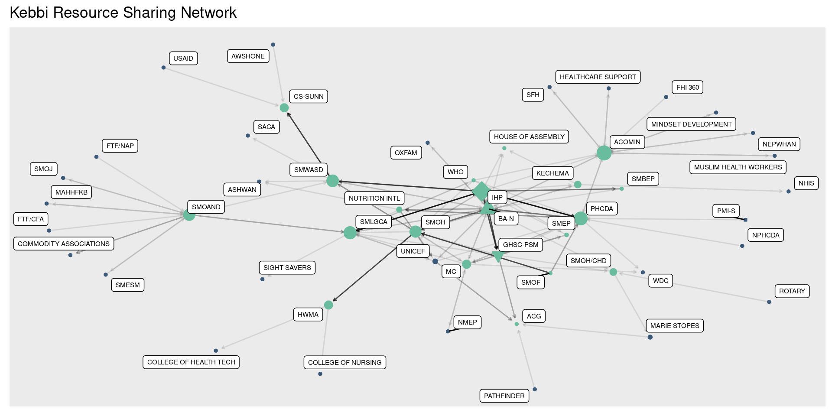
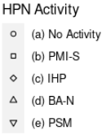

Resource sharing network
Notes:
And here is the network diagram based on those responses.
It’s a little hard to see, but the darker lines represent situations where the respondent said resource exchange happened more often. You can see from the legend on the left that the green nodes are survey respondent organizations; blue ones are nominees who weren’t also respondents. Finally, shape codes show which nodes reflect HPN Activities including their IPs.

Slide 91

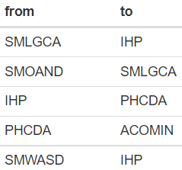
Who is most central to resource sharing?
Organizations
Relationships
Notes:
Which organizations and relationship are most central to resource sharing in Kebbi? You can see from the top list that these are IHP, ACOMIN (civil society in malaria control, immunization, and nutrition), the state primary healthcare development agency (PHCDA), BA-N, and the Ministry of local government and chieftancy affairs (SMLGCA). Many of the most central relationships involve the same groups.

Slide 92
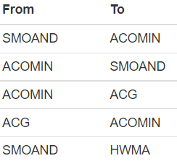
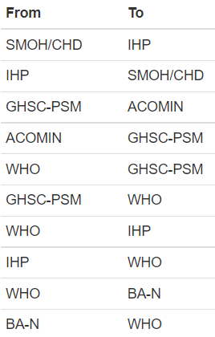
What could make resource sharing more efficient?
All Relationships
HPN Activity Relationships
Notes:
A one-time measure of network efficiency by itself is hard to interpret or apply to programming. So we modeled the changes in efficiency that would result from making new resource sharing connections. Remember, some of these connections might not be feasible in context, but this analysis can help stimulate discussion about different options.
You can see from the list at the top that initiating resource sharing between ACOMIN (civil society in malaria control, immunization, and nutrition) and several other groups would be most helpful for increasing overall efficiency, by bridging the two sides of the network. Linking ACOMIN and SMOAND (state ministry of agriculture and natural development) would have the largest effect.
Continuing with modeling to understand how new relationships might be strategic, we identified relationships *involving HPN Activity implementers directly* that would improve the efficiency of resource sharing the most. Our thought was that these relationships might be more feasible to implement. Resource sharing between the state ministry of health (community health department) and IHP came out on top

Slide 93
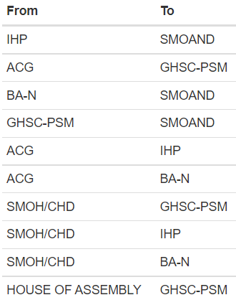
What could make government more central?
HPN Activity Relationships
HPN Activity relationships
Notes:
The last modeling exercise is focused on HPN Activity-involved relationships that would improve the centrality of government organizations in the network the most. Here we reasoned that helping to ensure that government is central to exchange (in this case, resource exchange), could help sustain health programming and its outcomes.
You can see from the list that government centrality in this network could increase the most by establishing a resource sharing relationship from IHP to the state ministry of agriculture and natural development (SMOAND).

Slide 94
Summary points
Most central to resource exchange are: IHP; Civil Society in Malaria Control, Immunization, and Nutrition (ACOMIN); primary healthcare development agency (PHCDA).
New resource sharing involving the Ministry of Agriculture and Rural Development (SMOAND) and ACOMIN could increase efficiency.
New resource sharing relationships (e.g., from IHP to SMOAND, or from Advocacy Core Group to PSM) could also increase government centrality.
Stakeholders should consider the feasibility of forming these relationships as part of strategy development

Slide 95
Information sharing
Information: technical, training, educational, both formal and informal.
“How often does your organization provide information to (name)?”
“How often does your organization receive information from (name)?”
Notes:
Now we’re going to move on from resource sharing and look at information sharing. For each organization that a respondent organization nominated, we asked…

Slide 96
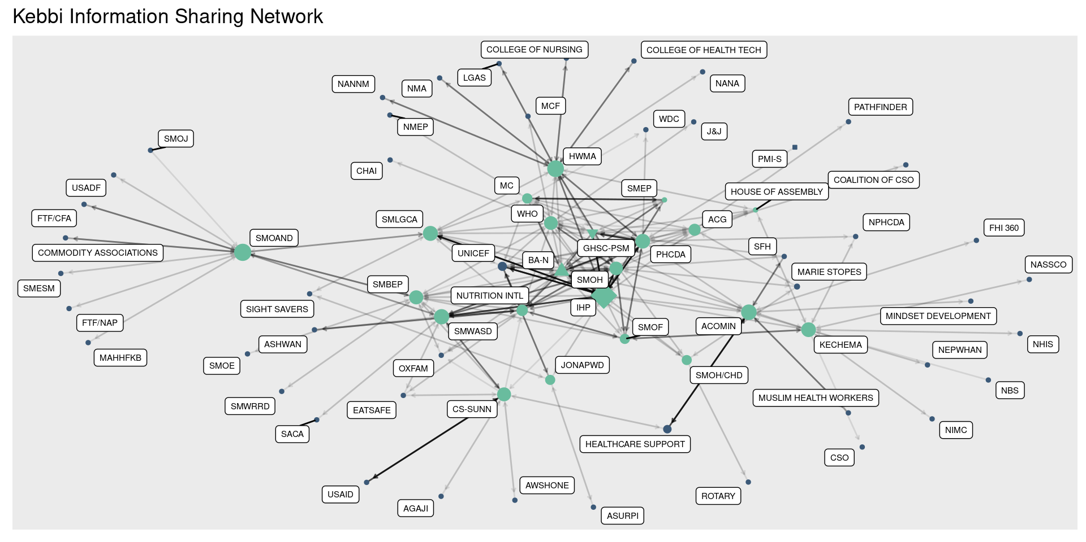
Information sharing network
Notes:
Thinking back how the resource sharing network looked, which network do you think has higher density – resource sharing, or information sharing?
Yes - density is higher for information sharing: there are more organizations in the diagram, with more lines connecting them. Reciprocity is also higher here. This makes sense, because information sharing generally costs organizations less and is easier to do, and therefore is more common. But still, the diagrams show that there is a lot of both types of exchange happening.

Slide 97

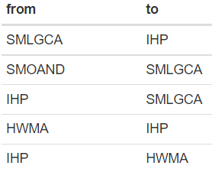
Who is most central to information sharing?
Organizations
Relationships
Notes:
In Kebbi, the state ministry of agriculture and natural development (SMOAND) and the health workforce management activity (HWMA) along with IHP are among the most central to information sharing. The most central relationships involve these organizations too, along with the state ministry of local government and chieftancy affairs (SMLGCA).

Slide 98
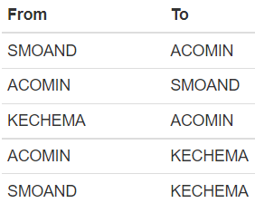
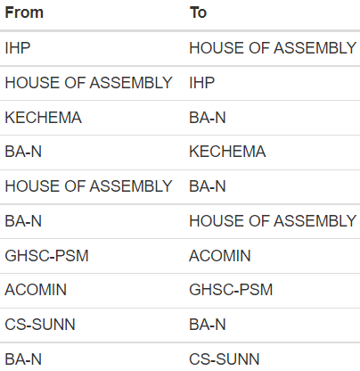
What could make information sharing more efficient?
All Relationships
HPN Activity Relationships
HPN Activity relationships
Notes:
SMOAND and ACOMIN (civil society in malaria control, immunization and nutrition) working together could increase the efficiency of information sharing the most. Limiting the modeling to HPN Activity-involved relationships highlights the potential for improved efficiency through linking IHP to the House of Assembly, among others.

Slide 99
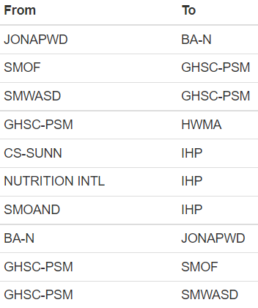
What could make government more central?
HPN Activity Relationships
Notes:
Finally, modeling shows that the biggest increases in government centrality for information sharing could come from linking the Joint National Assoc of Persons with Disability (JONAPWD) to BA-N. and linking the state ministry of finance (SMOF) and the state ministry of women and social development (SMWASD) to PSM. Initiating information exchange from PSM to the health workforce management activity (HWMA) would also increase government centrality in this network.

Slide 100
Summary points
Density, reciprocity, and efficiency are all higher for information sharing than resource sharing – but there is a lot of both kinds of exchange happening.
IHP, the State Ministry of Agriculture and Natural Development, and the Health Workforce Management Activity are central to information exchange.
Efficiency could be increased through information sharing relationships involving the State Ministry of Agriculture and Rural Development and Civil Society in Malaria Control, Immunization, and Nutrition.
New information sharing links (e.g., from the Joint National Association of Persons with Disability to BA-N) could also increase government centrality.

Slide 101
Food for thought...
Did any of these results seem inconsistent with your experience of HPN Activity collaboration and coordination? Did any resonate?
Are resource and information sharing important in this program context? What other kinds of exchange would you like to see analyzed?
New linkages could increase the efficiency of resource and information exchange. Is more efficiency important? Are these relationships feasible?
Other new linkages could increase the centrality of government in these networks. Is that a good proxy for sustainability? What else might be?

Slide 102
For more information, contact:
Emmanuel Adegbe
eadegbe.fpcape@gmail.com
08036243309
Milissa Markiewicz
milissa@unc.edu
Data for Impact (D4I)
https://www.data4impactproject.org/

Slide 103
This presentation was produced with the support of the United States Agency for International Development (USAID) under the terms of the Data for Impact (D4I) associate award 7200AA18LA00008, which is implemented by the Carolina Population Center at the University of North Carolina at Chapel Hill, in partnership with Palladium International, LLC; ICF Macro, Inc.; John Snow, Inc.; and Tulane University. The views expressed in this publication do not necessarily reflect the views of USAID or the United States government.
www.data4impactproject.org

